Slide 1
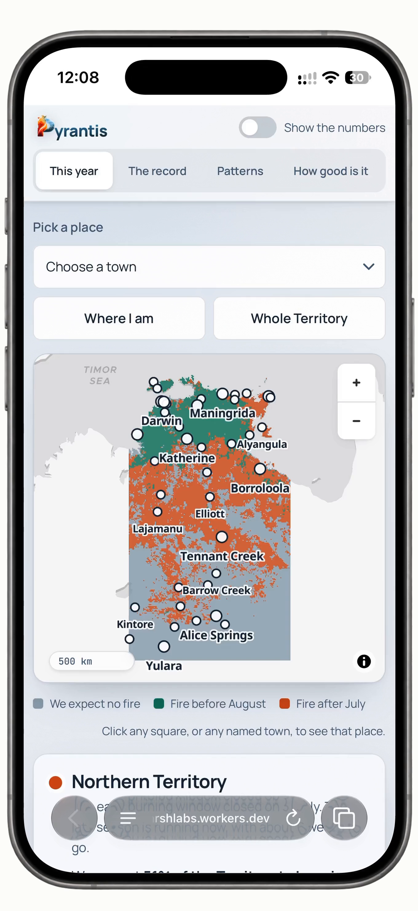
CHARLES DARWIN UNIVERSITY
PYRANTIS
Which country burns in the Northern Territory, and when
Multi-class classification of 46,445 map squares across 26 fire years, and a forecast for 2026.
UNIT
Machine Learning, Artificial Intelligence and Algorithms
TEAM
UNIT CODE
PRT565
Harsh Rastogi
386401
ASSESSMENT
Assessment 3 — Presentation
Saira Zafar
407193
GROUP
Group 85
Tharushi Wimalachandra
387594
RECORDING (UNLISTED)
https://youtu.be/c_0yCsdZX2U
pyrantis.harshlabs.workers.dev
Notes:
SLIDE 1 · 0:00 – 0:39
Good morning. Every year, most of the Northern Territory burns. That is not a disaster — that is the season. What decides whether a fire is a management tool or a catastrophe is not whether it
happens. It is when.
We are Group 85 — I am Harsh Rastogi, with Saira Zafar and Tharushi Wimalachandra. Our project is Pyrantis. For every five-kilometre square of the Territory, for every year since 2000, we classify what happened — no fire, a fire before August, or a fire after July — and then we forecast 2026.

Slide 2
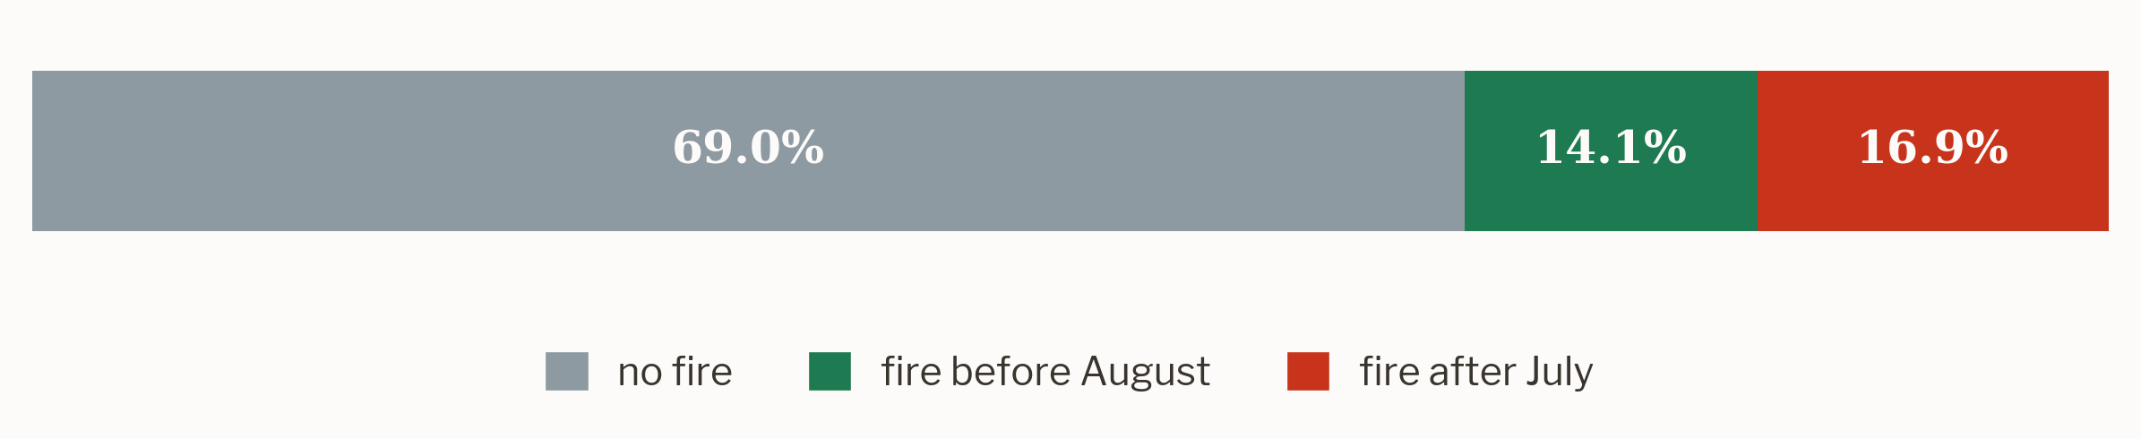
THE SETTING
Most of the Territory burns.
The question is when.
1,207,570
square-years of fire record
Across 2000 to 2025, roughly a third of the Northern Territory carried a fire in any given year. Nearly a million square-years of record say the same thing: burning is not the exception here, it is the season.
46,445
map squares, five kilometres across
EVERY SQUARE, EVERY YEAR, 2005 TO 2025
2
Harsh Rastogi
Notes:
SLIDE 2 · 0:41 – 1:11
Across 2000 to 2025, roughly a third of the Territory carried a fire in any given year — 1.2 million square-years of record, across 46,000 map squares. Look at the split. 69% of those square-years saw no fire. 14.1% burned before August. 16.9% burned after July. Hold on to that imbalance, because the rarest answer is the one we care about most.

Slide 3
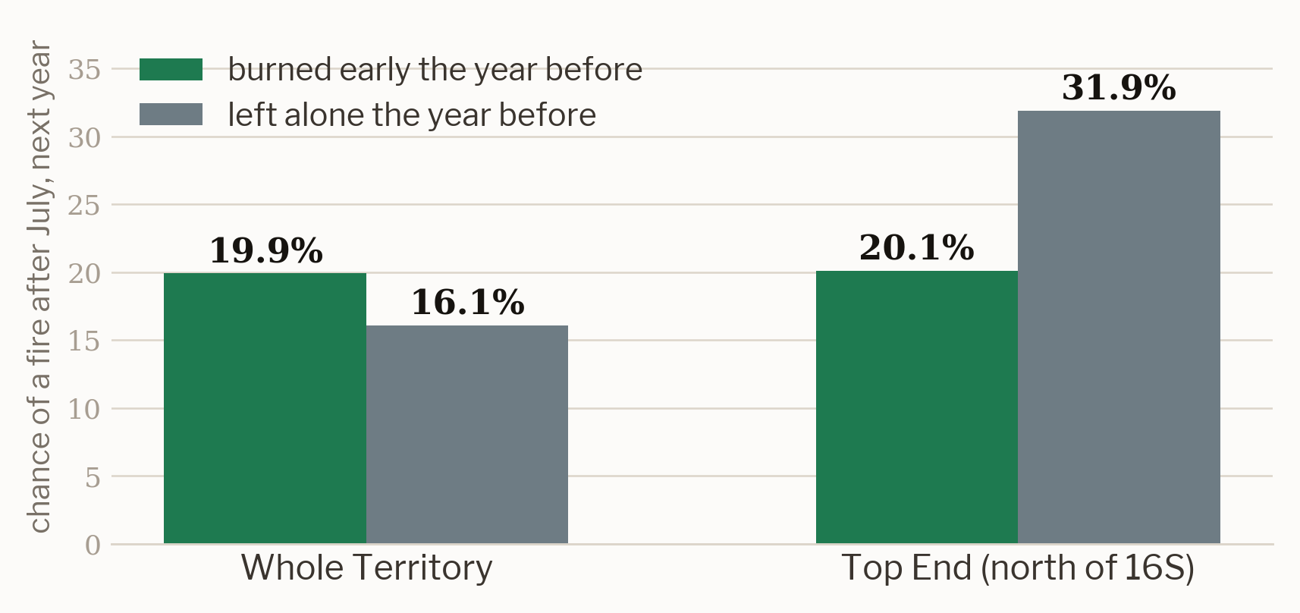
WHY IT MATTERS
A fire in June and a fire in October are different events.
Before August
After July
The country is still damp from the wet. Fires are cool, they creep, and they leave a patchwork. Rangers light these deliberately to break up the fuel.
The grass has cured. Fires run with the wind, burn hot enough to kill canopy, and take out fences, stock and country in a single afternoon.
And it compounds.
In the Top End, country burned early is far less likely to carry a late fire the next year — 20.1% against 31.9% for country left alone. Territory-wide the comparison reverses, because the arid south burns on a different clock. One number for the whole map would have hidden both facts.
3
Harsh Rastogi
Notes:
Before August the country is still damp. Fires are cool and they leave a patchwork — rangers light these deliberately to break up the fuel. After July the grass has cured, and fires run with the wind, hot enough to kill canopy and take out fences, stock and country in an afternoon.
And it compounds. In the Top End, country burned early carries a late fire the next year about 20.1% of the time, against 31.9% for country left alone. Territory-wide that reverses, because the arid south runs on a different clock — which is why we predict square by square, not region by region.

Slide 4
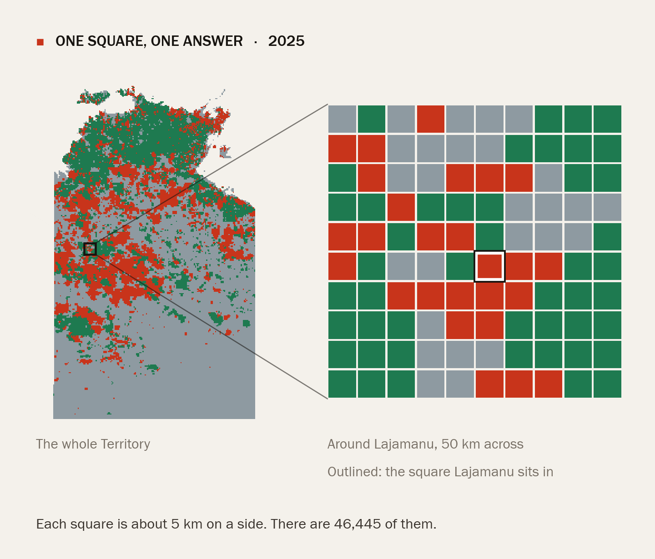
THE QUESTION WE SET
For every square, for every year:
which of three?
unburnt
no fire detected that year
early
first detected on or before 31 July
late
first detected after 31 July
The 31 July line is the one the Territory's own fire management uses, so the classes mean something to the people who would act on them.
4
Harsh Rastogi
Notes:
So the question we set is a 3-class problem. For every square, for every year: unburnt, early, or late.
Early means first detected on or before the 31st of July; late means after it. That date is not ours — it is the line the Territory’s own fire management uses, so the classes mean something to the people who would act on them.

Slide 5
THE DATA
Three public sources, joined on one grid.
NAFI
SILO
MODIS
North Australian Fire Information
Queensland Government Data Drill
MOD13Q1 via Google Earth Engine
250 m burnt-area rasters, 2000 to 2025. Each pixel carries the month it was detected — which is what makes an early/late label possible at all.
Daily rainfall, temperature, humidity and radiation, interpolated from Bureau of Meteorology stations to the same 0.05° grid.
Sixteen-day vegetation index. How green the country got over the wet season is how much fuel is standing when the dry arrives.
All three are open data, used under their own licences and cited in the report. Nothing in this project sits behind a login.
0.05°
2000–2025
50
966,819
grid cell, about 5 km
years of fire record
features per square-year
rows used for modelling
5
Harsh Rastogi
Notes:
NAFI gives us 250-metre burnt-area rasters back to 2000, and each pixel carries the month it was
detected — which is what makes an early-or-late label possible at all. SILO gives us daily weather on the same grid. And MODIS gives us satellite greenness: how much fuel is standing when the dry
arrives.
All three are open data, cited in the report. Nothing here sits behind a login. That leaves 50 features across 966,819 rows.
Saira will take you through how we turned that into something a model can learn from.

Slide 6
02
ACT TWO
How we built it
Turning satellite scars into labels, deciding what the model is allowed to know, and proving it never saw the answer.
Saira Zafar
6

Slide 7
LABELLING
From burnt pixels to one answer per square.
1
Read the scar
The check that mattered
Each NAFI pixel holds the month it burned, 1 to 12, or zero for no fire.
Labels are the one thing no metric can catch. So we tested them against fire history the Territory already knows: 2011, the year after the 2010–11 La Niña, comes out as the heaviest on record at 65.7% of the map burnt. 2020 comes out the lightest at 15.9%. Both match the published record. If the labels had been wrong, every number after this would have been wrong too.
2
Pool to a square
Every 20 × 20 block of pixels becomes one 0.05° cell, and we count what fraction burned early and what fraction burned late.
3
Decide the class
A square counts as burnt only if at least 5% of it burned, and is only used at all if at least half its pixels were readable. Whichever season holds more of the burnt area names the year.
7
Saira Zafar

Slide 8
FEATURES
Only what a forecaster could
actually know on 30 April.
30 April
the cut-off, every feature, every year
The forecast has to be useful before the fire season starts, so every one of the 50 features is built from information available by the end of April in the year being predicted — and nothing later.
Fire history
Years since the last fire and the last late fire, how often it burnt over 3, 5, 10, 15, 20 and 25 years, what it did last year, and what its neighbours did.
26 features
Weather
Wet-season rainfall, heat, humidity deficit and sunlight, plus the dry season before it, and how far the wet sat from its own local normal.
14 features
Greenness
How green the country got over the wet, where it peaked, how fast it greened up, and how far April sat above or below normal.
7 features
Place
Longitude, latitude and elevation, so the model can tell the Top End from the arid south without being handed the regions.
3 features
8
Saira Zafar

Slide 9
LEAKAGE
Two rules, because a leak would flatter every number after it.
A feature that quietly reads the year it is meant to predict will score beautifully and mean nothing. We did not trust ourselves to avoid that by being careful, so we tested for it twice.
RULE ONE
RULE TWO
Recomputation
Scrambling
Every fire-history feature is rebuilt from years strictly before the target year, in one function that both the training path and the forecast path call. A second implementation would have drifted, and the drift would have been silent — the forecast has no label to check itself against.
We shuffled one year's labels and rebuilt the features. If anything were reading the answer, the scores would have collapsed or held suspiciously steady. They moved exactly as much as chance says they should.
Both checks are scripts in the repository, not claims in a slide.
9
Saira Zafar

Slide 10
VALIDATION
Split by time, never at random.
Fire years are not independent draws. A random shuffle would put 2024 in training and 2023 in test, and the model would be reading its own future. So the record is cut in chronological order and the last three years are never touched until the end.
Train
Tune
Test
2005 – 2019
2020 – 2022
2023 – 2025
fifteen years
three years
three years, seen once
2005
2025
And once was once. The test years were scored a single time, at the end, after every decision about features and models had already been made. Tuning against them would have turned the held-out years into another training set.
10
Saira Zafar

Slide 11
THE MODELS
Six models, two baselines, and one correction for imbalance.
Decision tree
the readable one
Why class weighting
Random forest
many trees, voting
Late fires are the ones that matter and the rarest thing on the map. Left unweighted, every model quietly stopped predicting them — it is cheaper to be right about the common answer. Weighting the classes makes that trade expensive.
Naive Bayes
the probabilistic floor
Multilayer ANN
a dense network
LSTM
reads the 26-year sequence
GRADIENT BOOSTING, F1 ON LATE FIRES
Gradient boosting
trees that correct each other
0.420
0.553
unweighted
weighted
Against two baselines: “whatever happened last year” and “always say unburnt”. A model that cannot beat those has learned nothing worth having.
11
Saira Zafar
Notes:
Finally, the models. As per requirement we used 5 model — decision tree, random forest, naive Bayes, a multilayer network, and an LSTM reading the twenty-six-year sequence — plus gradient boosting, which won. And two baselines: whatever happened last year, and always say unburnt. A model that cannot beat those has learned nothing. One correction mattered enormously. Late fires are the rarest thing on the map and the thing we care about most. Left unweighted, every model quietly stopped predicting them — it is cheaper to be right about the common answer. Weighting makes that trade expensive. For gradient boosting the score on late fires goes from 0.42 to 0.55. Same model, same data, same split. Tharushi will tell you whether any of this actually works

Slide 12
03
ACT THREE
Does it actually work?
Scores on years the models never saw, sixty-six separate re-tests, and the twenty-three experiments behind the one we kept.
Tharushi Wimalachandra
12

Slide 13
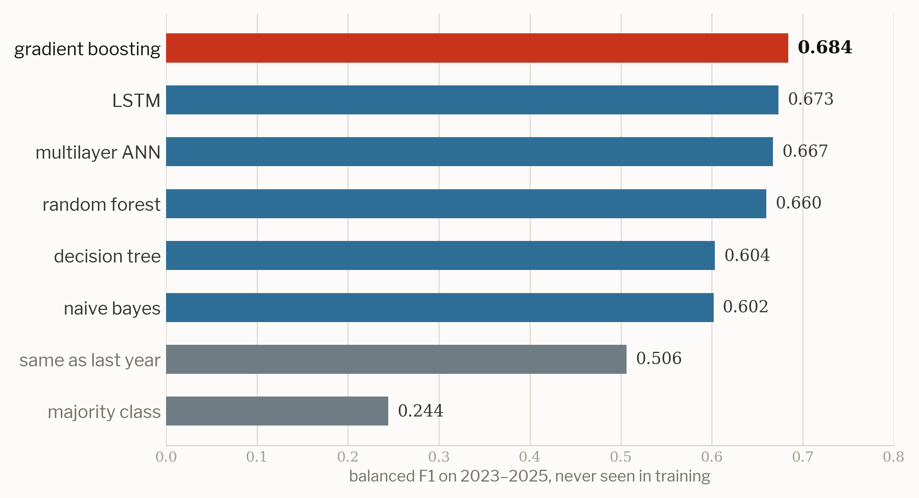
RESULTS
Gradient boosting wins, and every model beats the baselines.
Read it this way
Balanced F1 treats all three answers as equally important, so a model cannot score well by ignoring the rare ones.
The number to watch is the gap to “same as last year” at 0.506. That is what a fire officer already knows without us. Gradient boosting adds 0.178 on top of it.
Accuracy on the same years is 0.725.
13
Tharushi Wimalachandra

Slide 14
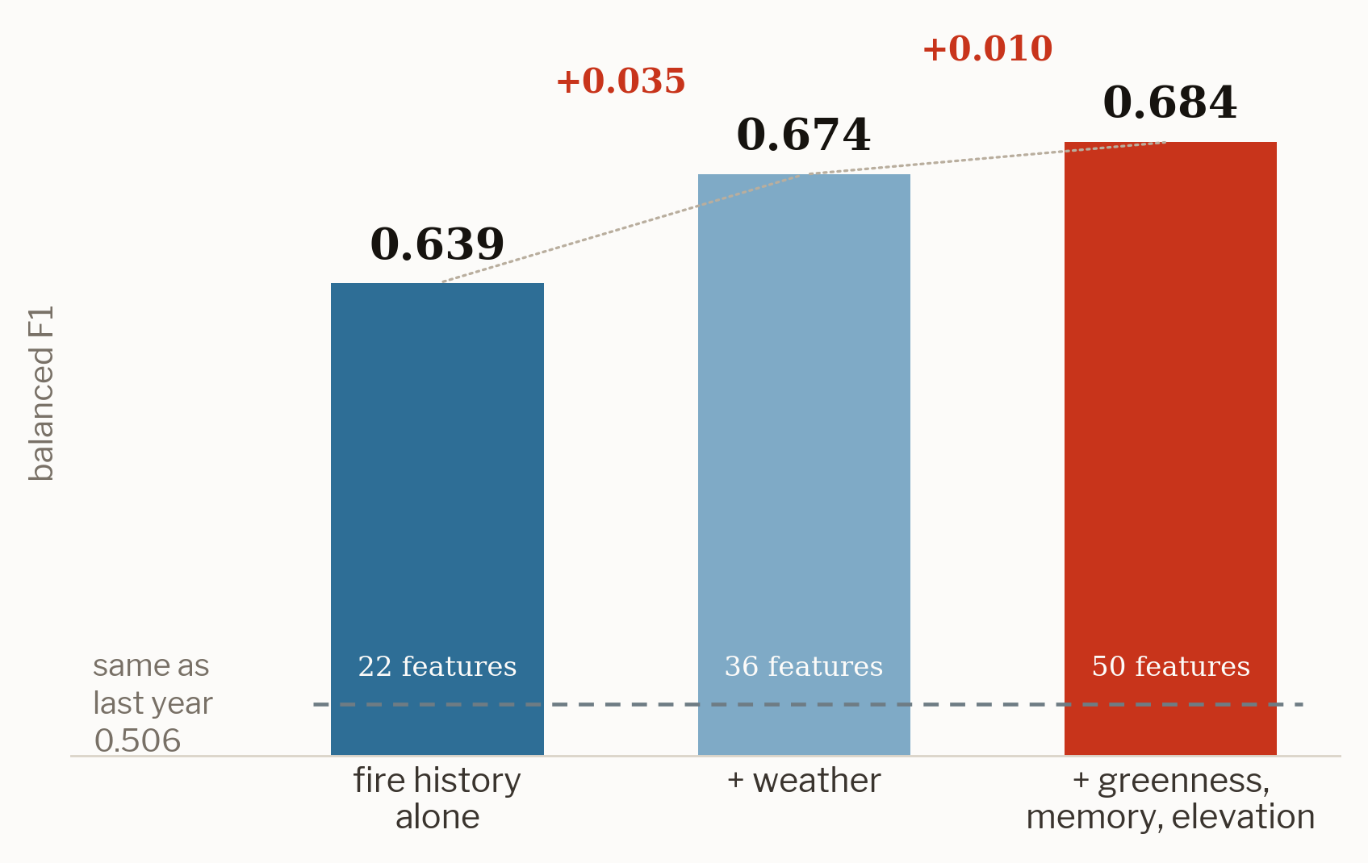
WHAT THE DATA BOUGHT
Weather earned its place. Greenness earned less, and we said so.
Adding the weather was the single biggest step in the project — +0.035, from knowing how wet the wet season was.
The third run adds greenness, longer fire memory and elevation together, for +0.010. Isolated in the experiment ledger, greenness on its own is worth +0.029.
We kept it, because it holds up on years the model never saw and because two of the model's five strongest inputs turn out to be greenness — even though Earth Engine cost ten minutes a run against sixty seconds for everything else.
14
Tharushi Wimalachandra

Slide 15
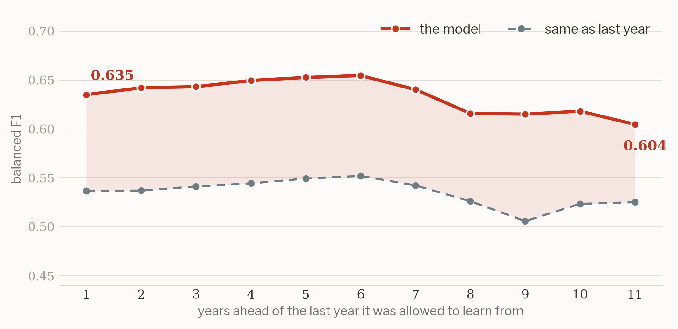
WALK-FORWARD TESTING
One good year could be luck. So we did it sixty-six times.
We cut the record at each year from 2014 to 2024, let the model learn only what came before the cut, and scored it on every year after — 66 separate tests.
The surprise
Skill does not fade with distance. Guessing one year ahead scores 0.635; eleven years ahead it still scores 0.604.
That is not the model being clever. It is telling us the strongest clue is the wet season just gone, which is known by the end of April however old the fire history is.
15
Tharushi Wimalachandra

Slide 16
CHECKING THE RESULTS
We tuned every model, and checked it would hold up.
Four checks, all scored on years the models had not seen.
Tuned properly
Checked for overfitting
0.684 → 0.684
0.821 → 0.684
A search over every model's settings, scored on the validation years only, left gradient boosting where it was. The decision tree gained most: 0.604 → 0.632.
Gradient boosting on the years it trained on, then on years it never saw. The random forest memorises far more: 0.924 → 0.660.
Scored beyond accuracy
Why not shuffled cross-validation
ROC-AUC 0.862 · PR-AUC 0.732
0.772 vs 0.677
These score the probabilities behind each answer. On late fires the PR-AUC is 0.558, about twice what guessing would get.
Shuffled 5-fold cross-validation leaks between neighbouring years and overstates the score. Testing forward in time gives the real figure.
16
Tharushi Wimalachandra

Slide 17
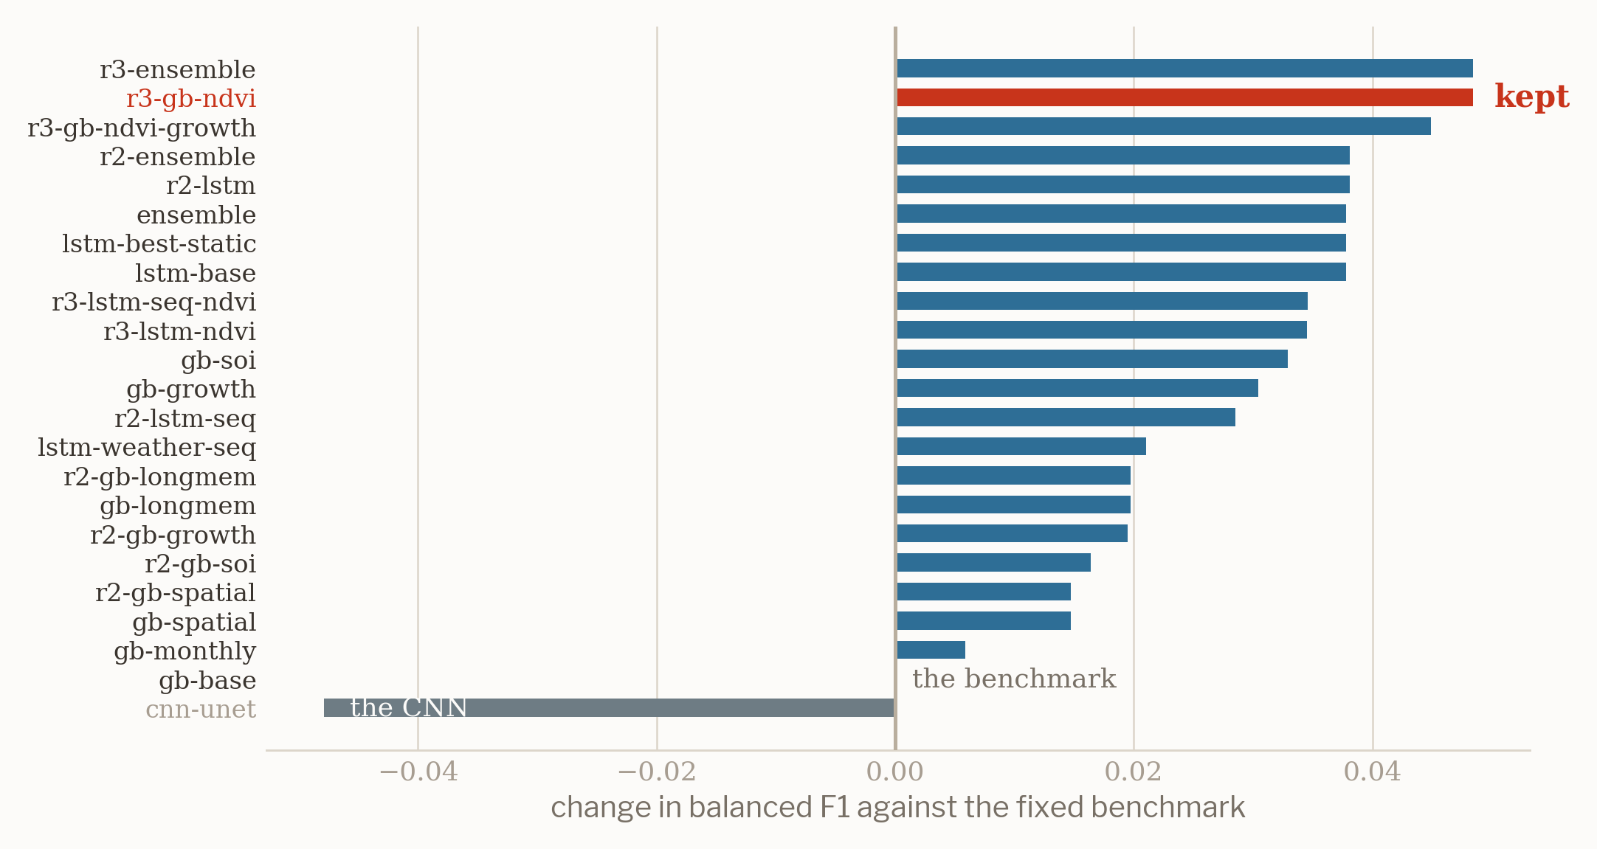
THE LEDGER
Twenty-three experiments against a fixed benchmark. One was kept.
Including the one that failed
We built a U-Net over the whole grid to let a convolutional network read fire as a picture rather than a table of numbers.
It scored 0.588 — 0.048 below the benchmark — so it went in the ledger as a reverted run and stayed out of the final model.
Every run was scored the same way, against the same fixed benchmark, and recorded whether it helped or not.
17
Tharushi Wimalachandra

Slide 18
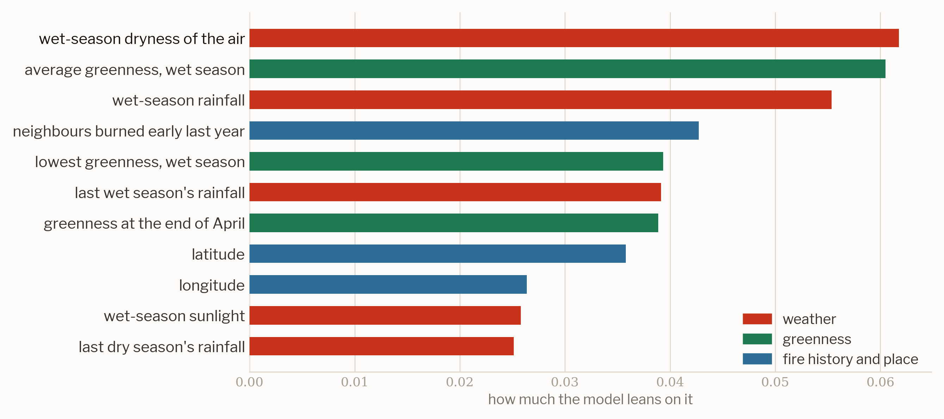
WHAT IT LEANS ON
The model rediscovered what land managers already knew.
Nobody told it that a wet, hot wet season grows the grass that carries an October fire. It found that in the data.
The top five inputs are the dryness of the air, average greenness, wet-season rainfall, what the neighbouring country did last year, and the lowest greenness of the wet.
That it lands where fire ecology already sits is the best evidence we have that it learned the problem rather than the dataset.
18
Tharushi Wimalachandra

Slide 19
LIMITATIONS
What this does not do.
Late fires are still the hardest call
The class that matters most is the one we predict worst. It is the rarest and the most weather-driven, and a year's weather after April is exactly what we refuse to look at.
balanced F1 0.553
A season, not a day
This says which squares are likely to burn and roughly when. It does not say which Tuesday, and it is not a fire-danger rating.
2026 is unverified
No burnt-area record exists for a year still running. The forecast is published as a claim that can be checked in 2027, not as a result.
One Territory, one grid
Everything is fitted to the NT at 0.05°. Whether it transfers to the Kimberley or Cape York is an open question, not an assumption.
19
Tharushi Wimalachandra

Slide 20
04
ACT FOUR
What it says about 2026
A forecast that can be checked next year, and the product that puts it in front of someone who is not a data scientist.
Harsh Rastogi
20
Notes:
Thanks Tharushi. The last part is the 2026 forecast, and the site we built for it.

Slide 21
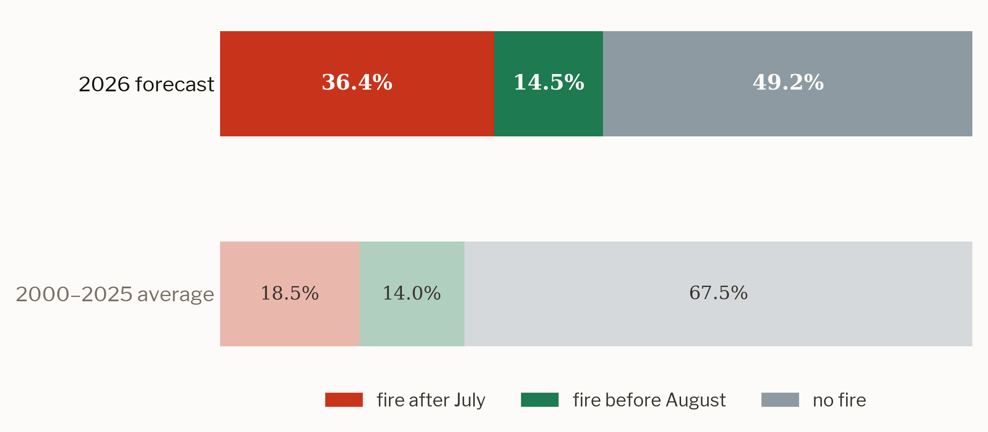
THE FORECAST
2026 is running heavy, and most of what is left will burn late.
51%
of the Territory forecast to burn in 2026, against a 26-year average of 33%
The model reads a wet season that delivered 783 mm — 45% above the 2005 to 2019 average and the second wettest in 22 years — and the greenest April on record at 0.46.
More water grew more grass. More grass is more fuel.
Mean confidence across the map is 0.733. No fire scars exist for 2026 yet, so this is a claim we can be held to in 2027.
21
Harsh Rastogi
Notes:
So, 2026.
The model expects 51% of the Territory to burn this year, against a 26-year average of 33%. 49.2% before August, 36.4% after July. A heavy year, and most of what is left will burn late.
It reads that out of a wet season that delivered 783 millimetres — 45% above the 2005 to 2019 average, and the second wettest in 22 years — together with the greenest April on record. More water grew more grass. More grass is more fuel. Mean confidence across the map is 0.733. And because no fire scars exist for 2026 yet, this is not a result — it is a claim we can be held to in 2027.

Slide 22
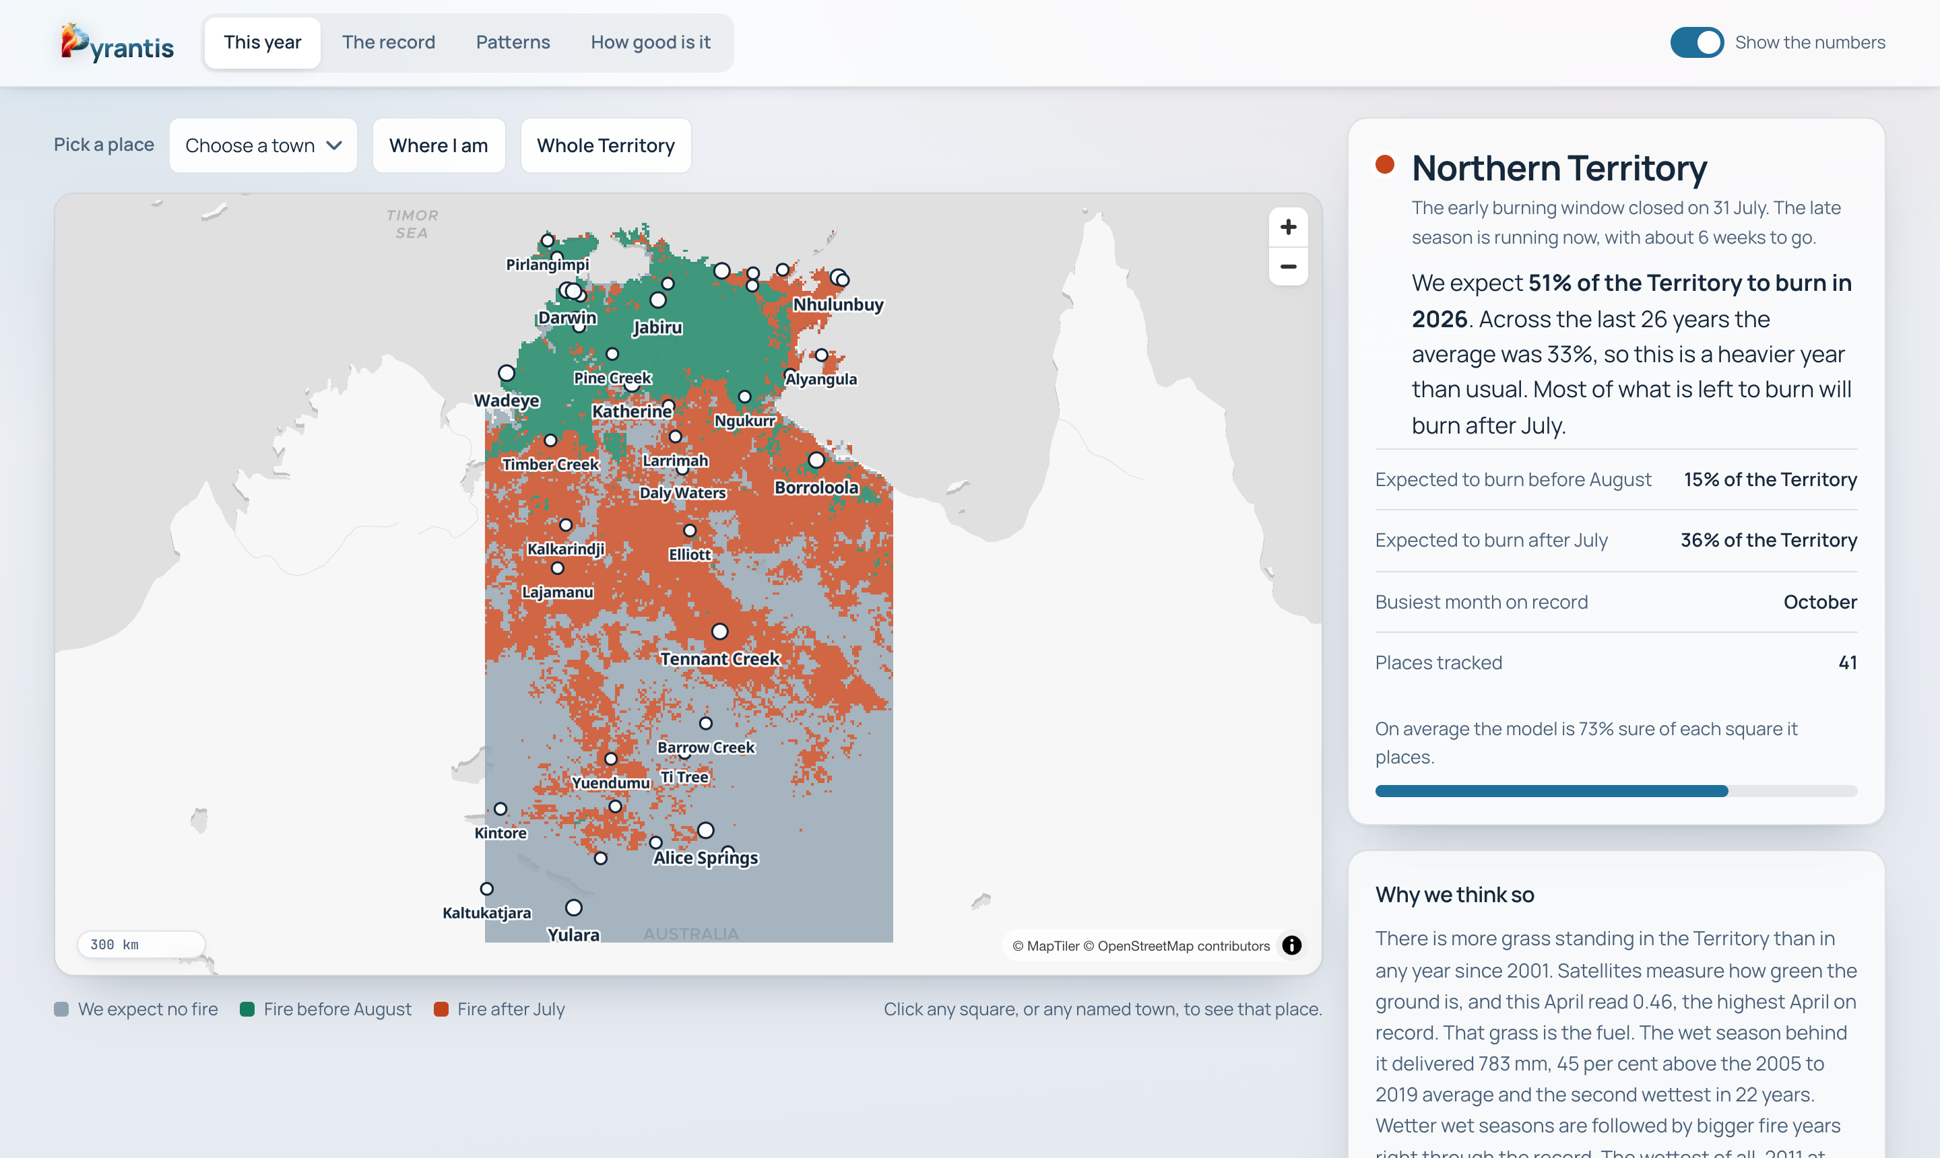
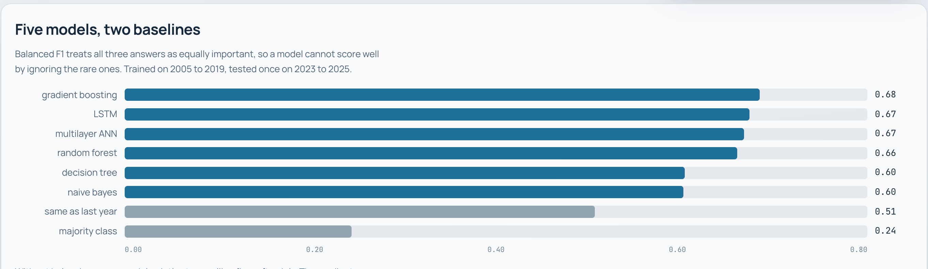
THE PRODUCT
A model in a notebook helps nobody.
So we shipped it: a public site that answers the question in plain English first, and shows the map, the record and the evidence underneath.
How good is it — every model, scored on years it never saw
This year — the forecast for any town or square
22
Harsh Rastogi
Notes:
So we shipped it.
This is a public site. It answers the question in plain English first, then puts the map, the 26-year record and the evidence underneath. You can click any square, or pick any of 41 named towns.
Every sentence on it is computed from the model output, so it updates when the data does.

Slide 23
Every square, every year, and an honest number on how often it is right.
Fire in the Territory is not going to stop. Knowing in April which country is likely to carry an October fire is how a burning programme gets planned while there is still time to plan it.
pyrantis.harshlabs.workers.dev
github.com/harshrastogii/PYRANTIS
Every figure in this deck is generated from the repository, not typed in.
0.684
66
51%
balanced F1, years never seen
independent re-tests
forecast to burn in 2026
23
Notes:
To close.
Every square, every year, and an honest number on how often it is right. A balanced F1 of 0.684 on years the models never saw. 66 independent re-tests behind that figure. And a forecast of 51 for 2026 that can actually be checked.
Fire in the Territory is not going to stop, and it should not. Knowing in April which country is likely to carry an October fire is how a burning programme gets planned in time.
Everything — the code, the figures in this deck, and the site — is in the repository, and every source we used is referenced on the last two slides.

Slide 24
REFERENCES
References (1 of 2)
American Psychological Association, 7th edition
Breiman, L. (2001). Random forests. Machine Learning, 45(1), 5–32. https://doi.org/10.1023/A:1010933404324
Chollet, F., & others. (2015). Keras [Computer software]. https://keras.io
Didan, K. (2021). MODIS/Terra vegetation indices 16-day L3 global 250 m SIN grid V061 [Data set]. NASA EOSDIS Land Processes Distributed Active Archive Center. https://doi.org/10.5067/MODIS/MOD13Q1.061
Friedman, J. H. (2001). Greedy function approximation: A gradient boosting machine. The Annals of Statistics, 29(5), 1189–1232. https://doi.org/10.1214/aos/1013203451
Gorelick, N., Hancher, M., Dixon, M., Ilyushchenko, S., Thau, D., & Moore, R. (2017). Google Earth Engine: Planetary-scale geospatial analysis for everyone. Remote Sensing of Environment, 202, 18–27. https://doi.org/10.1016/j.rse.2017.06.031
Harris, C. R., Millman, K. J., van der Walt, S. J., Gommers, R., Virtanen, P., Cournapeau, D., … Oliphant, T. E. (2020). Array programming with NumPy. Nature, 585(7825), 357–362. https://doi.org/10.1038/s41586-020-2649-2
Hochreiter, S., & Schmidhuber, J. (1997). Long short-term memory. Neural Computation, 9(8), 1735–1780. https://doi.org/10.1162/neco.1997.9.8.1735
Hunter, J. D. (2007). Matplotlib: A 2D graphics environment. Computing in Science & Engineering, 9(3), 90–95. https://doi.org/10.1109/MCSE.2007.55
24

Slide 25
REFERENCES
References (2 of 2)
American Psychological Association, 7th edition
Jeffrey, S. J., Carter, J. O., Moodie, K. B., & Beswick, A. R. (2001). Using spatial interpolation to construct a comprehensive archive of Australian climate data. Environmental Modelling & Software, 16(4), 309–330. https://doi.org/10.1016/S1364-8152(01)00008-1
North Australian Fire Information. (2026). Northern Territory fire scar mapping [Data set]. Darwin Centre for Bushfire Research, Charles Darwin University. https://firenorth.org.au
Pedregosa, F., Varoquaux, G., Gramfort, A., Michel, V., Thirion, B., Grisel, O., … Duchesnay, É. (2011). Scikit-learn: Machine learning in Python. Journal of Machine Learning Research, 12, 2825–2830.
Queensland Government. (2026). SILO climate data: Data Drill [Data set]. Long Paddock. https://www.longpaddock.qld.gov.au/silo/
Ronneberger, O., Fischer, P., & Brox, T. (2015). U-Net: Convolutional networks for biomedical image segmentation. In N. Navab, J. Hornegger, W. M. Wells, & A. F. Frangi (Eds.), Medical image computing and computer-assisted intervention – MICCAI 2015 (pp. 234–241). Springer. https://doi.org/10.1007/978-3-319-24574-4_28
Russell-Smith, J., Yates, C. P., Whitehead, P. J., Smith, R., Craig, R., Allan, G. E., Thackway, R., Frakes, I., Cridland, S., Meyer, M. C. P., & Gill, A. M. (2007). Bushfires 'down under': Patterns and implications of contemporary Australian landscape burning. International Journal of Wildland Fire, 16(4), 361–377. https://doi.org/10.1071/WF07018
25

